Slide 1
Cape Fear High School Chorus
School Year 2014-15

Slide 2
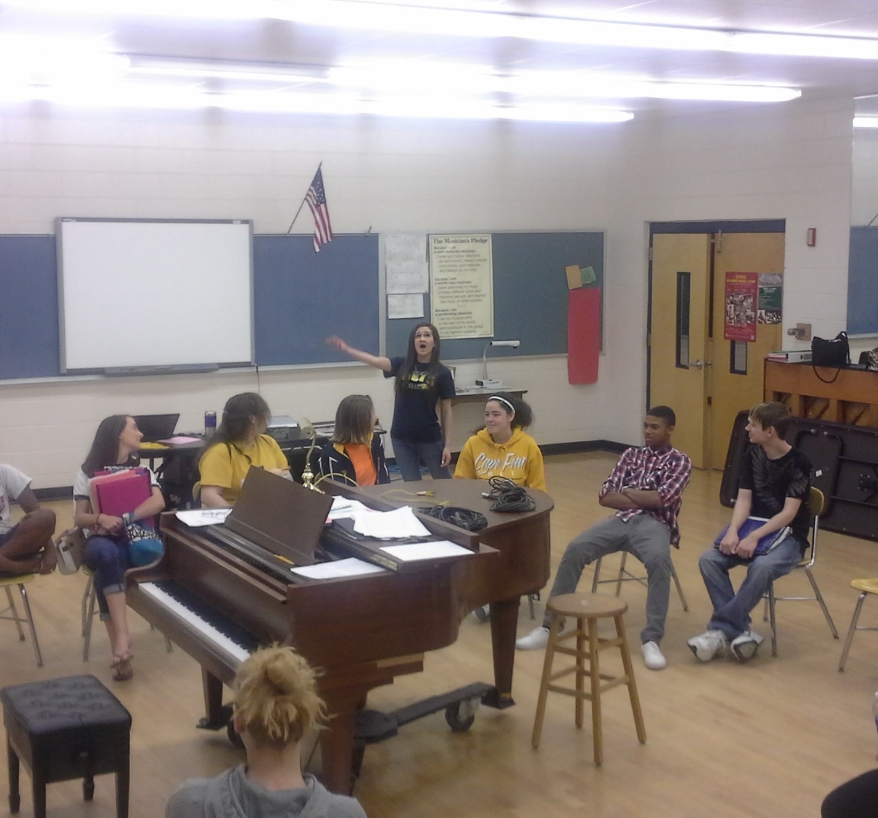
The Chorus
We all like the times we’ve had in Chorus.

Slide 3
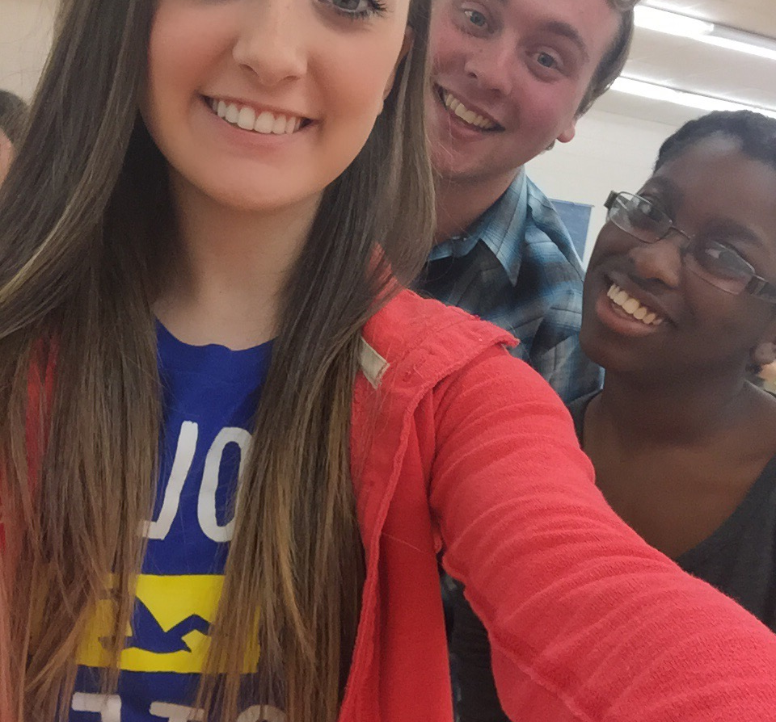
Excited!
Mr. Britt is letting me take a picture and I’m stoked!

Slide 4
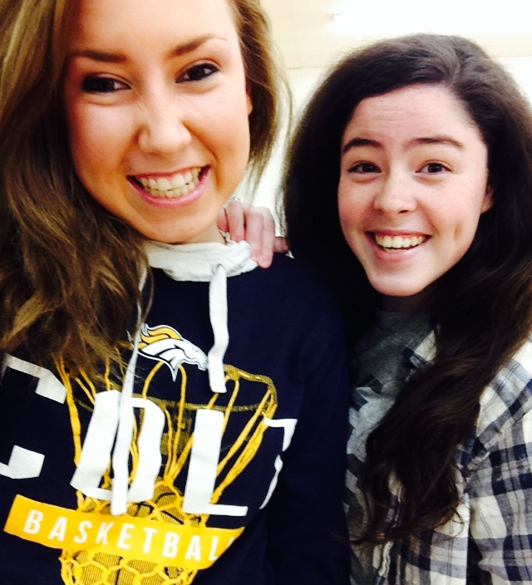
Say Cheese!
Cheesy!

Slide 5
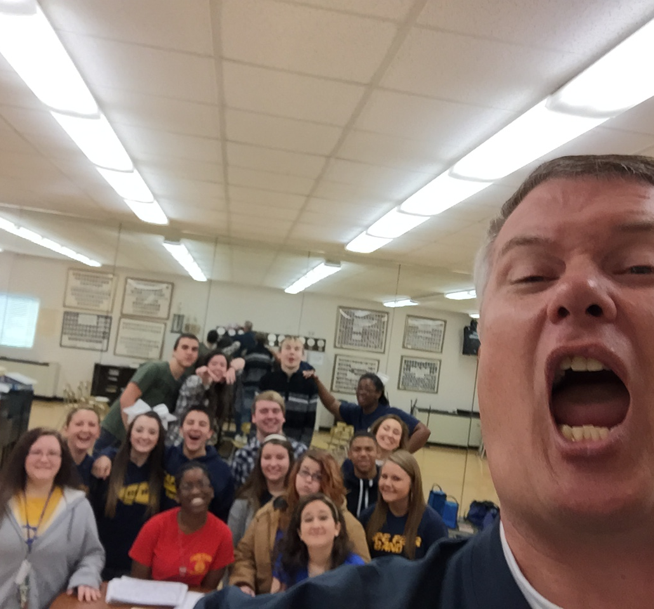
Get Me Out of Here!!!
No more coffee for Mr. Britt!

Slide 6
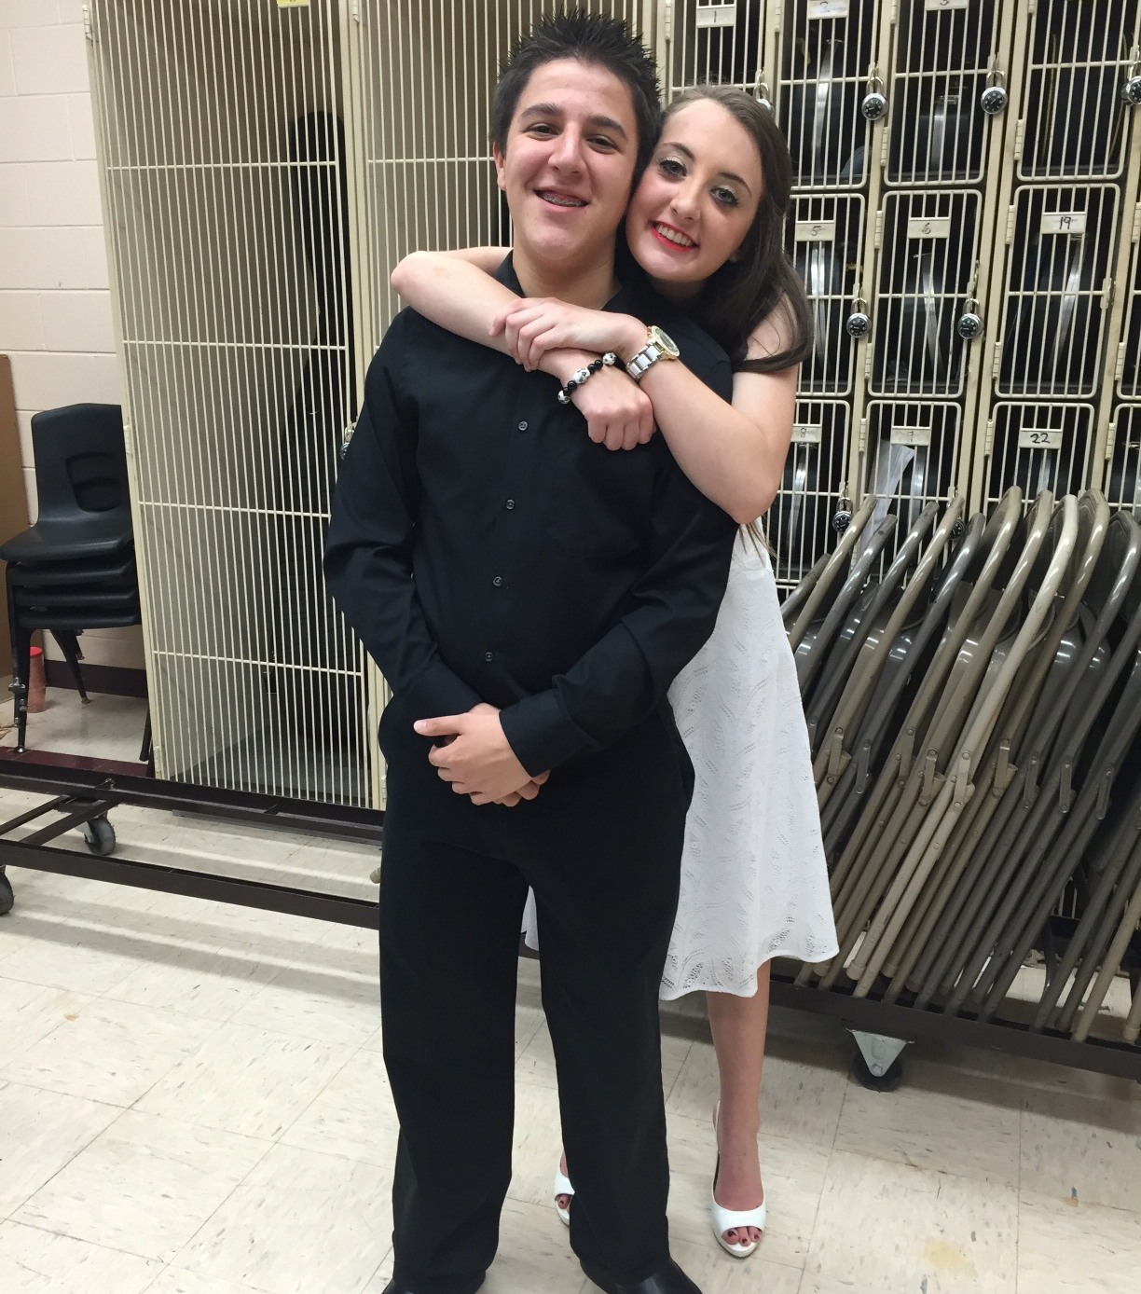
First Period
The future Mr. and Mrs. Harrison Pritchard

Slide 7
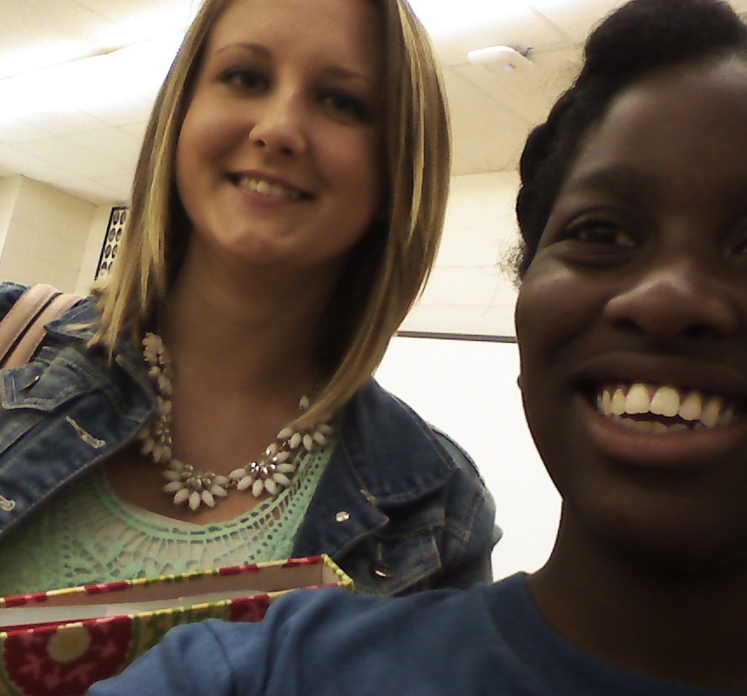
We Learn
I just learned how to use a camera!

Slide 8
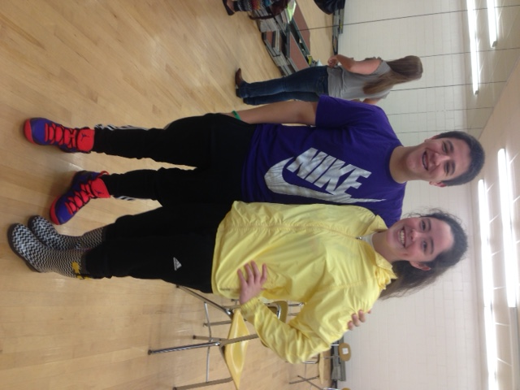
Strike a Pose
Hey Erin! It looks fine!

Slide 9
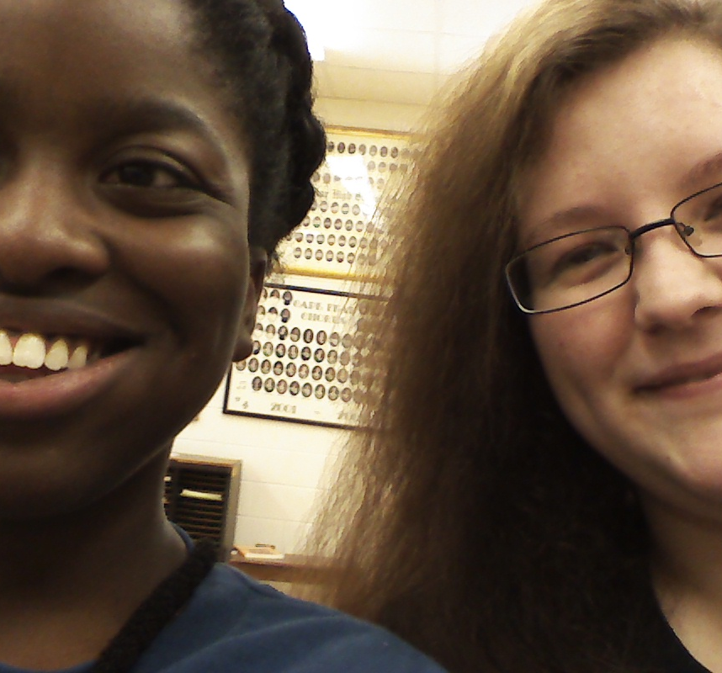
Altos
I am unsure about this camera!

Slide 10
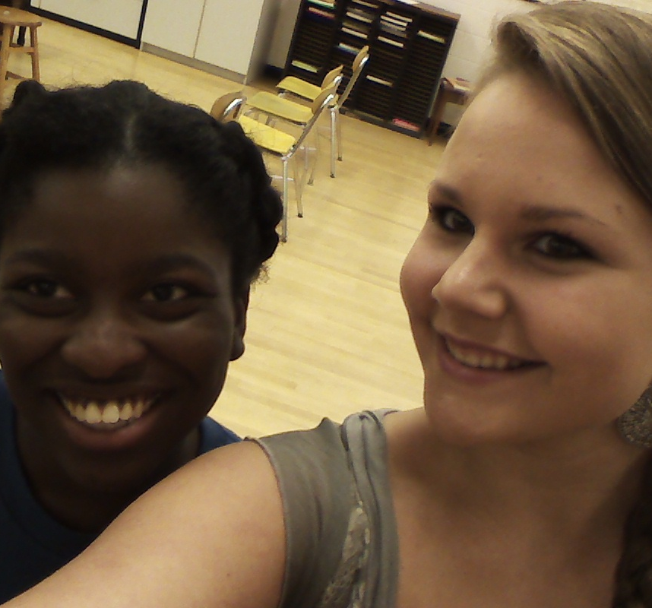
This is How You Do It
Erin knows how to use the camera!

Slide 11
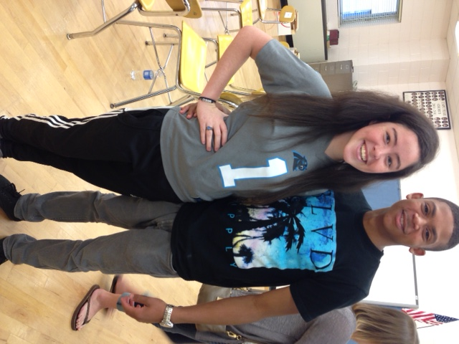
Picture Fail
…and you’ve cut off my head.

Slide 12
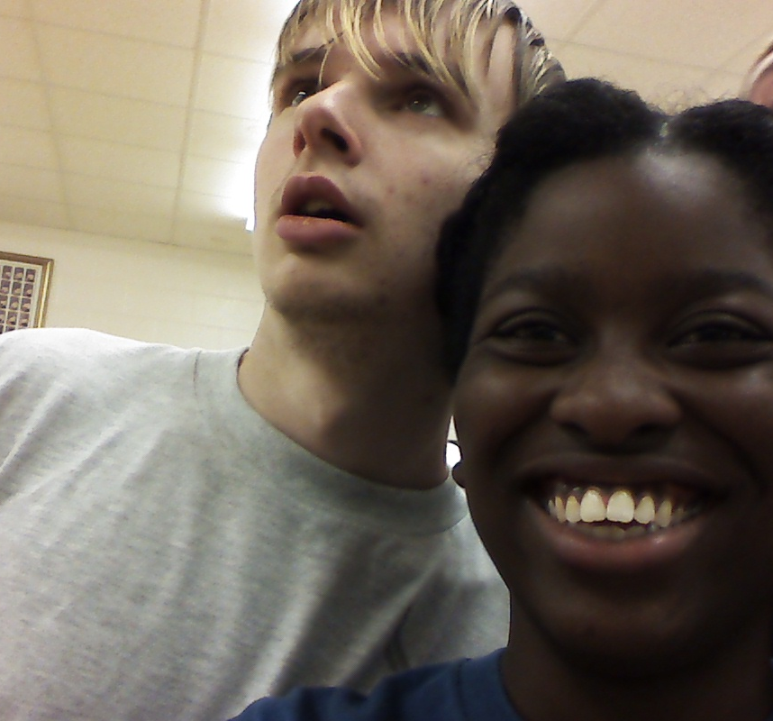
The Brains and the Clueless
Keyona has learned how to use the camera and Keiton realizes he has forgotten his homework.

Slide 13
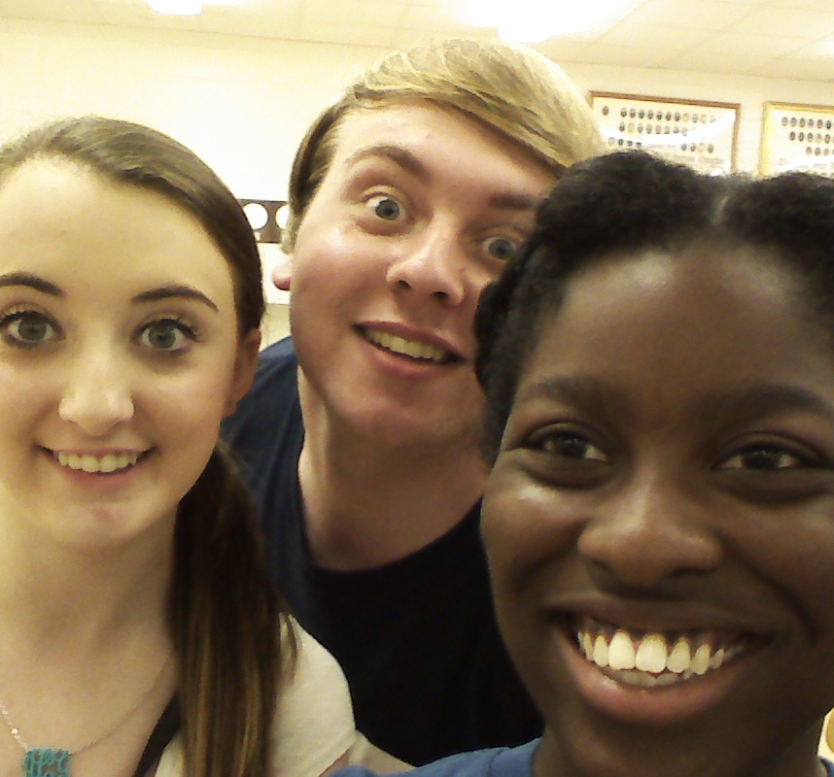
I’m Awake!!!
Someone just pinched Tyler.

Slide 14
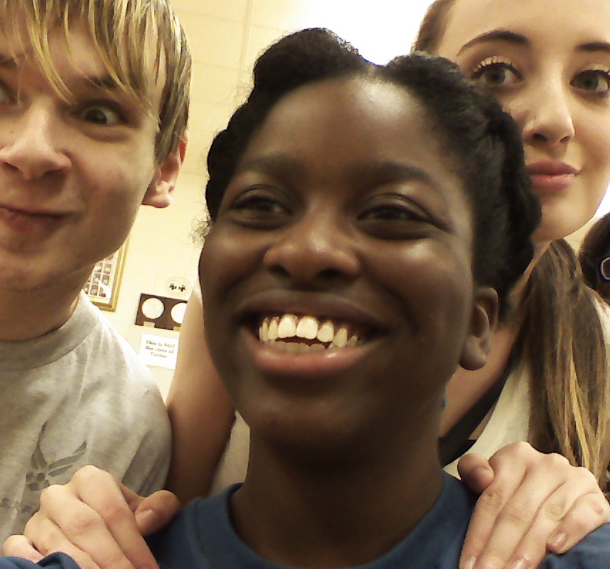
Look at that Face!
Yeah, cake!

Slide 15
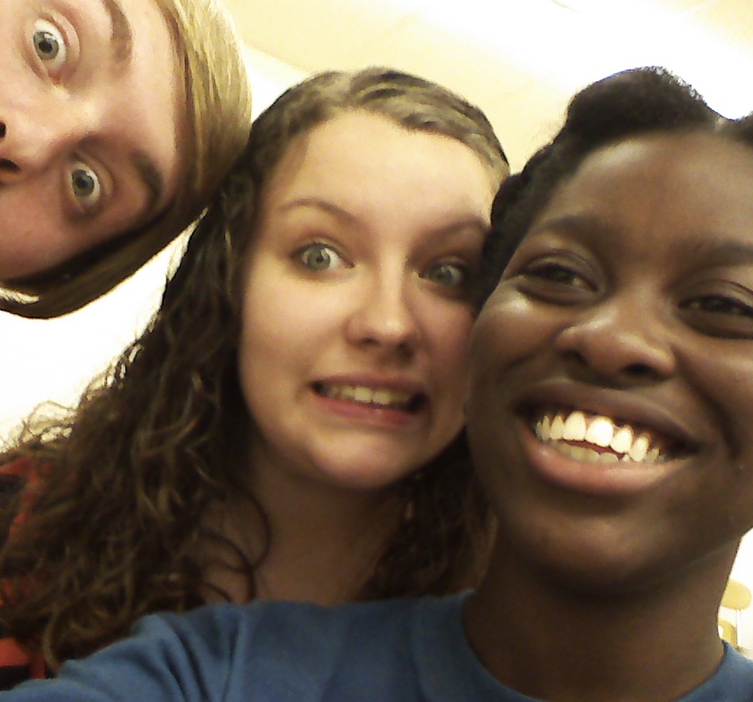
Uh Oh!!
Kristen is thinking that Tyler has officially gone crazy.

Slide 16
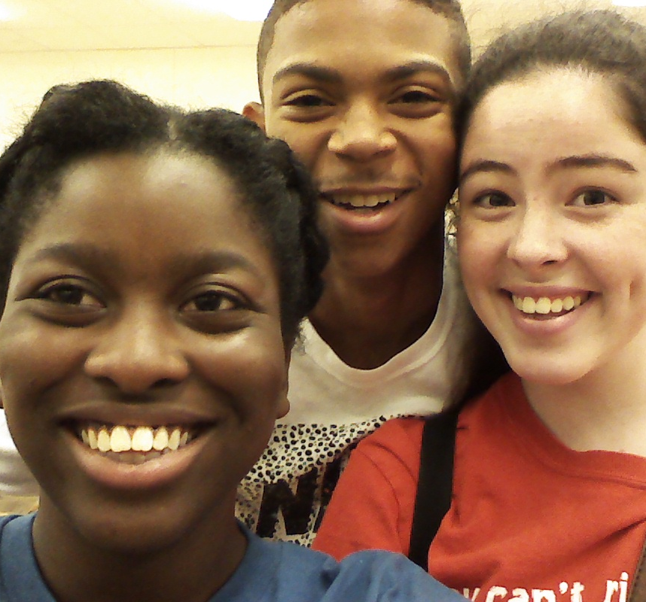
Dimples
FINALLY! Jordan smiles!

Slide 17
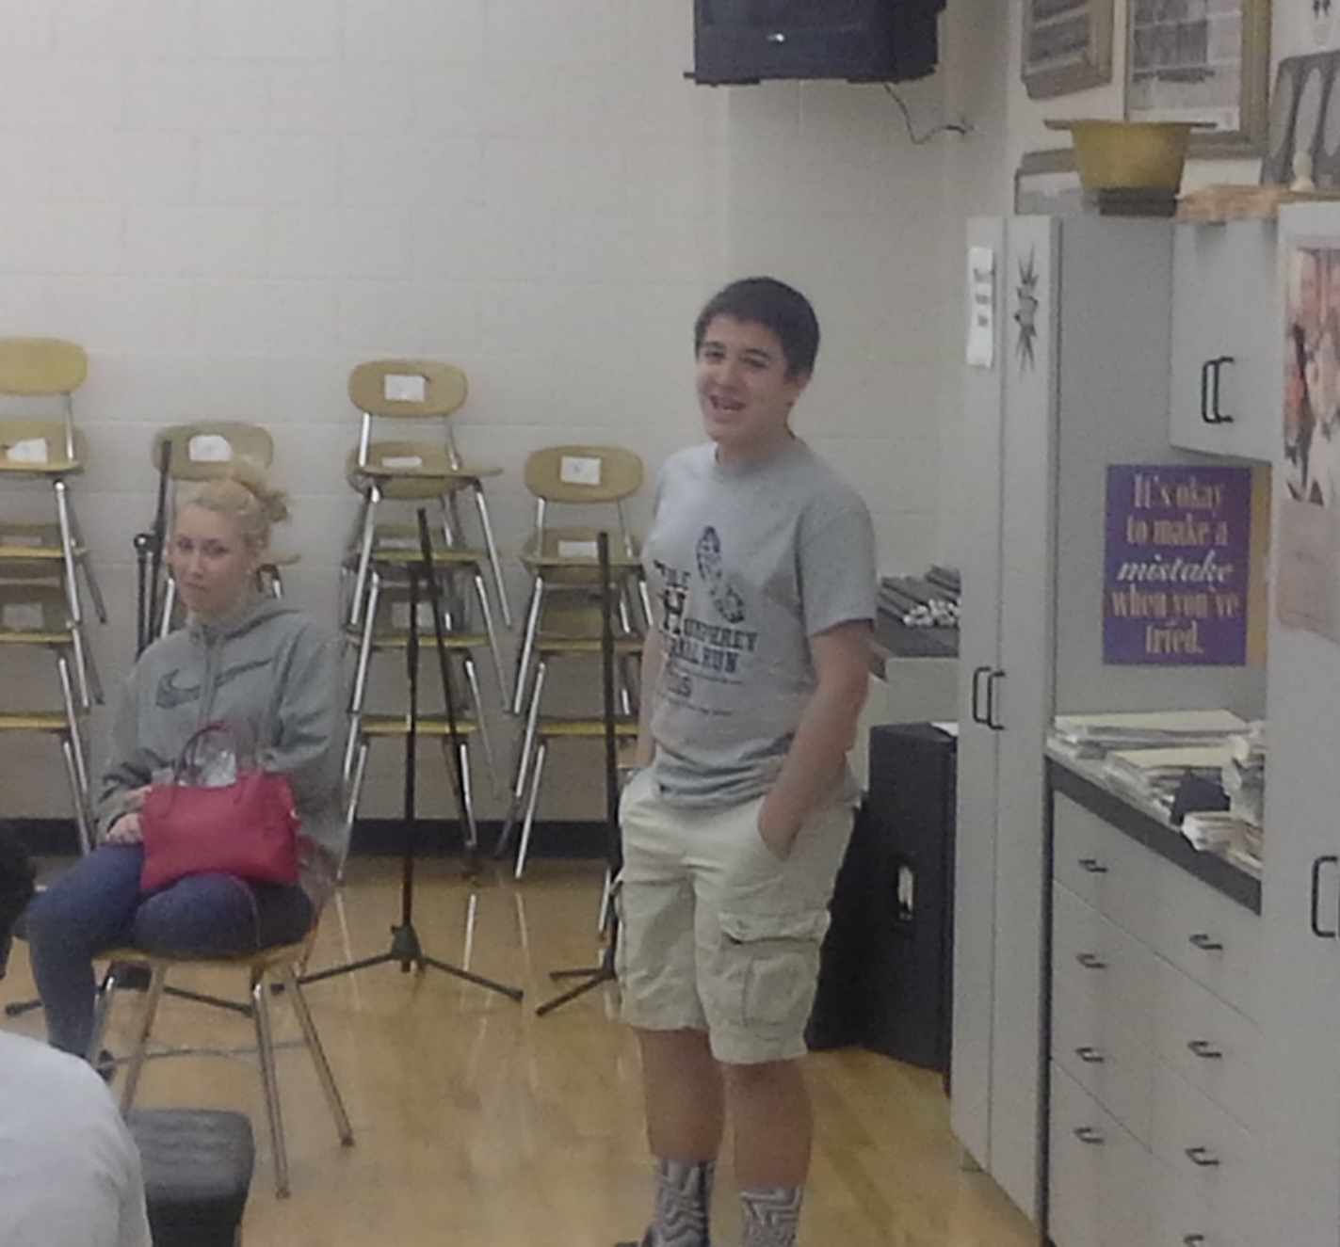
Change the Mood
Amanda is sad that Harrison can’t find any change in his pockets.

Slide 18
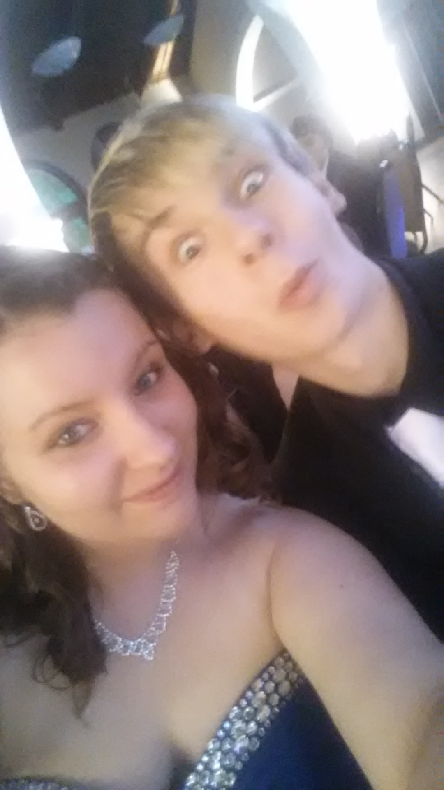
Stylin’ and Profilin’
Keiton just got the news that he won the lottery!

Slide 19
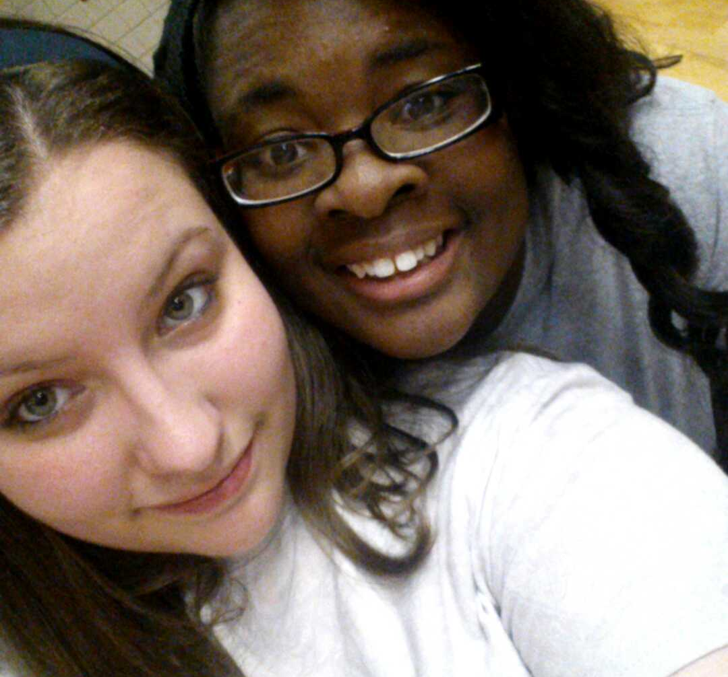
Look Here!
You mean there really is a Santa Claus?

Slide 20
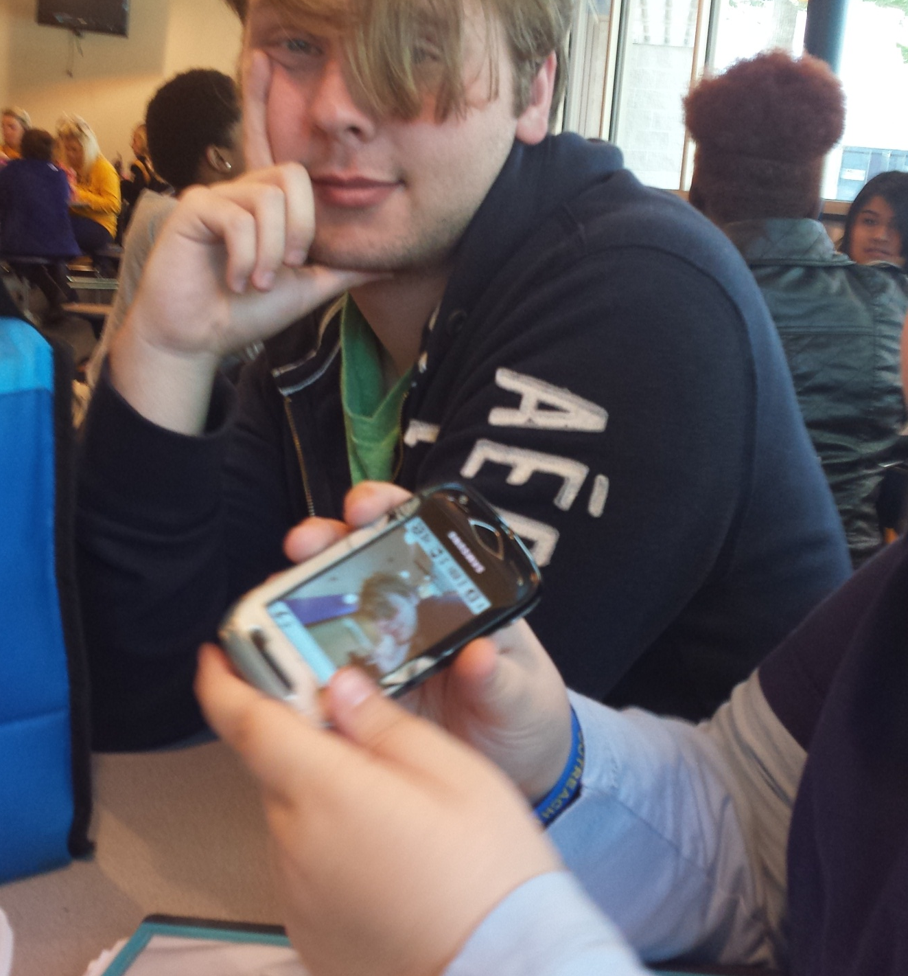
Long Day
I’ve had about enough of your crap!

Slide 21
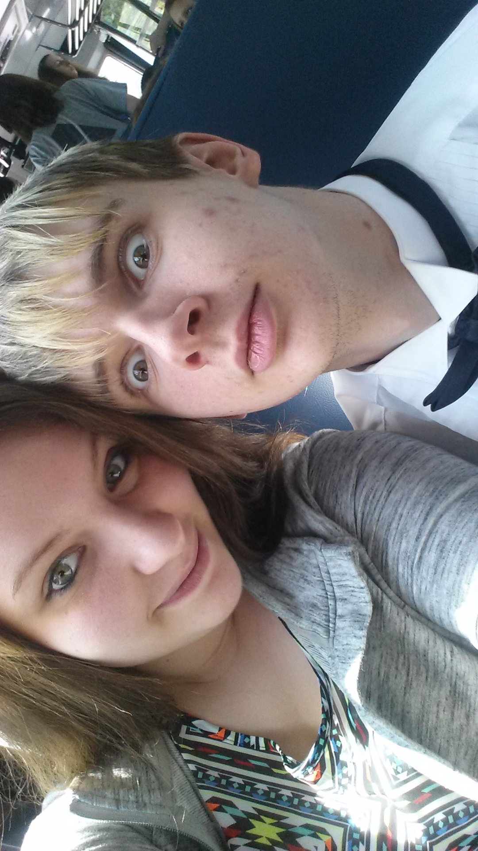
Disbelief
Man! Look at the size of that zit!

Slide 22

Good Friends
The future Mr. and Mrs. Pritchard.

Slide 23
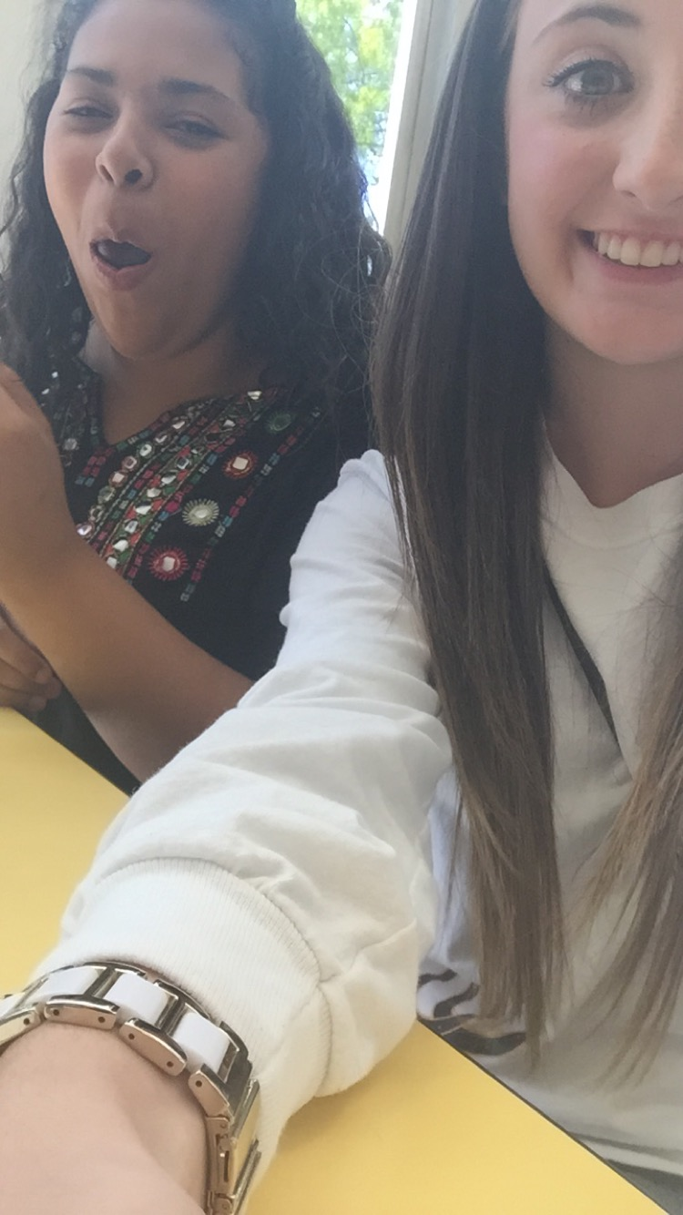
I wanna take a picture
Anna says “lubble, lubble, lubble!”.

Slide 24
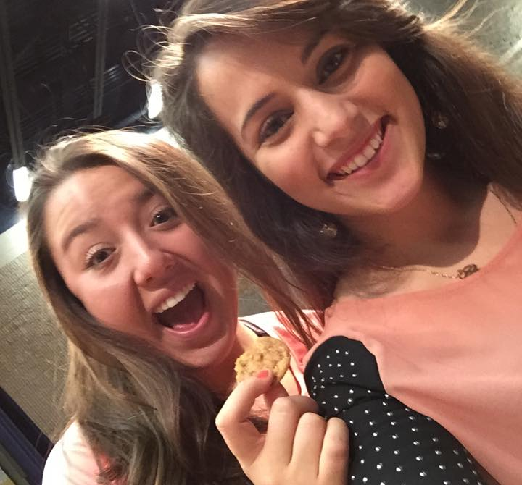
Second Period
Time for a cookie!

Slide 25
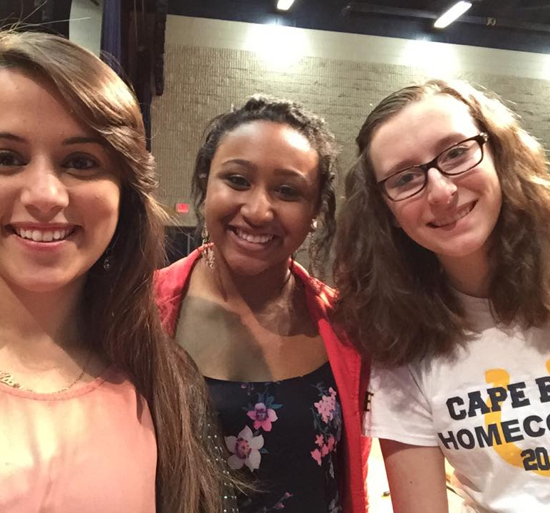
Second Period
Good friends.

Slide 26
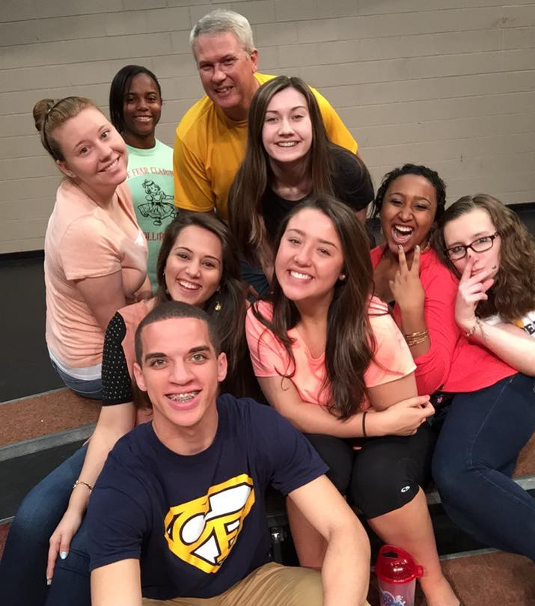
Second Period
Fooling around before a concert.

Slide 27
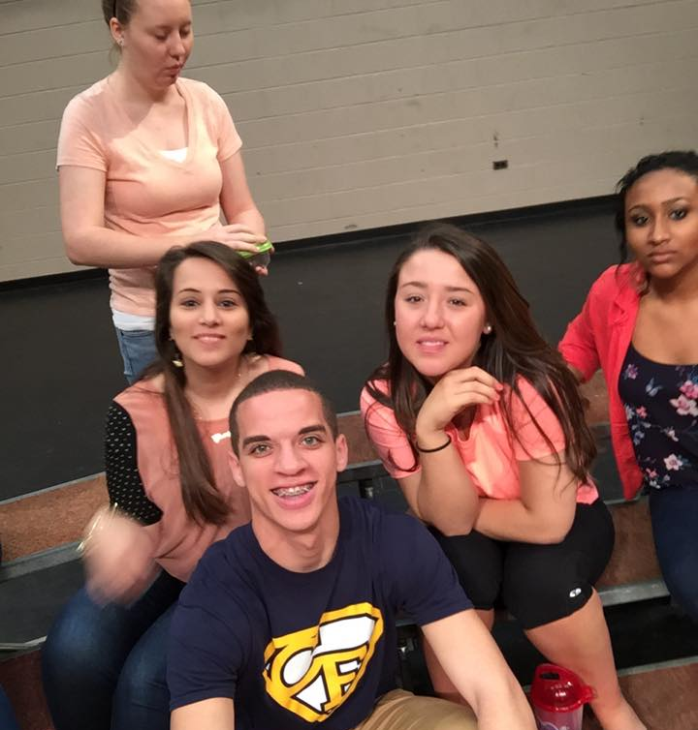
Second Period
I don’t think that Tara realizes we’re taking a picture. Hannah- what is that face?

Slide 28
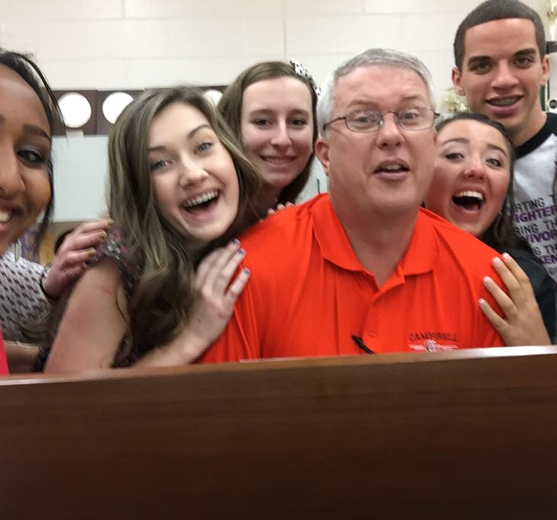
A Family Sing-Along
NOOOOOOO! DON”T TOUCH MEEEEEEEE!!!!

Slide 29
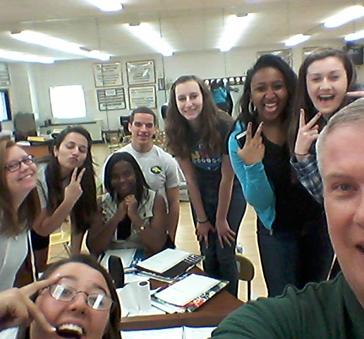
Good Days
What is Raniya doing?

Slide 30
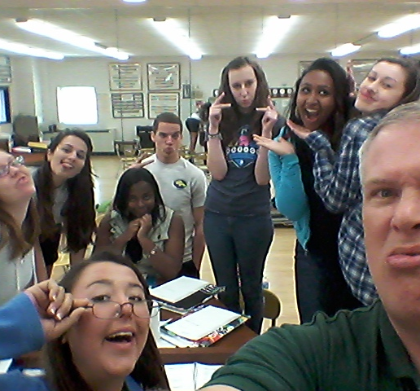
Getting Used to Taking Selfies
Hannah says “A little to the right, Mr. Britt!”

Slide 31
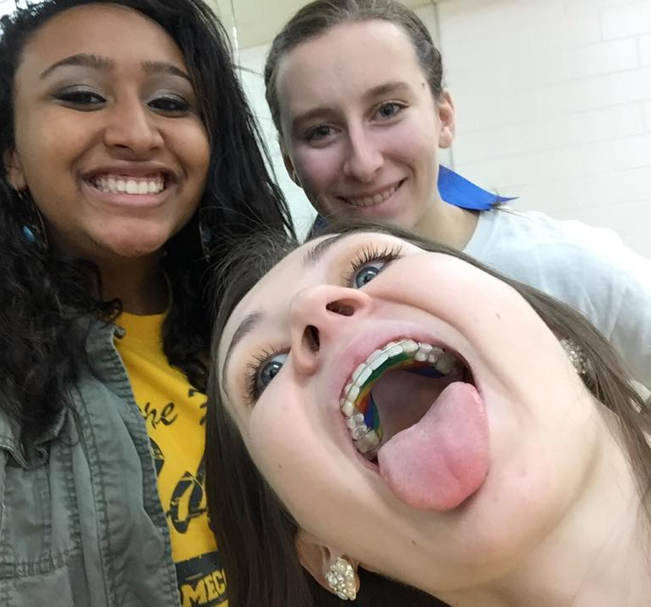
Wow, Just Wow!
Look! No boogers!

Slide 32
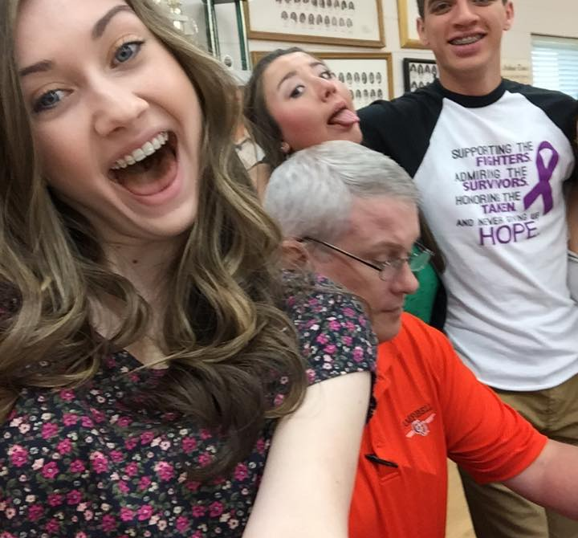
Sometimes Silly
I have no off button!

Slide 33
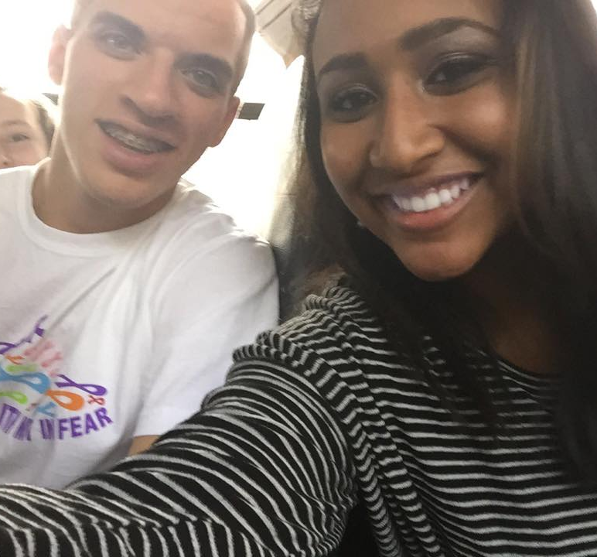
Second Period
Leila coerces Martin into a picture. Martin is thinking that Leila doesn’t know how to operate a camera.

Slide 34
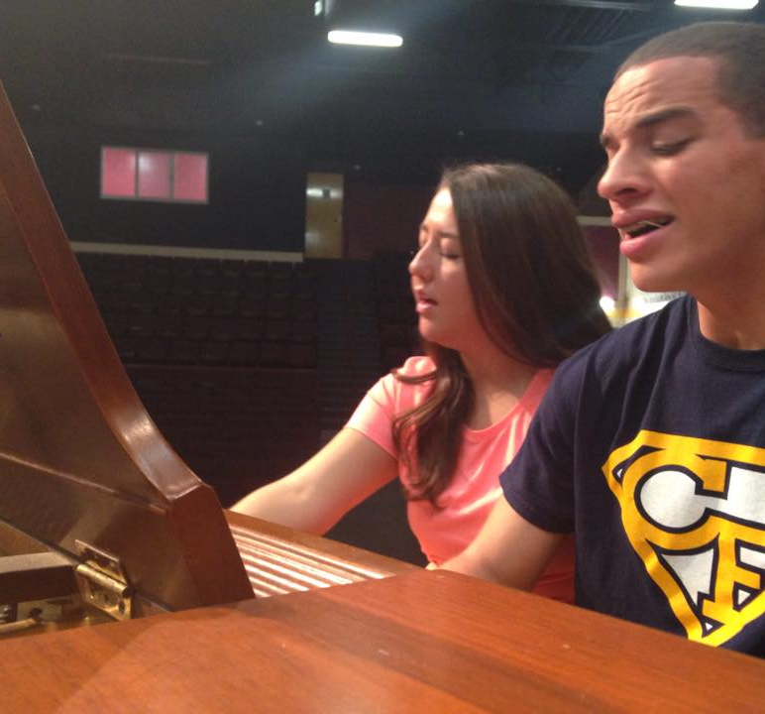
Can’t Stop Singing
Martin is at home playing and singing a duet with Hannah.

Slide 35
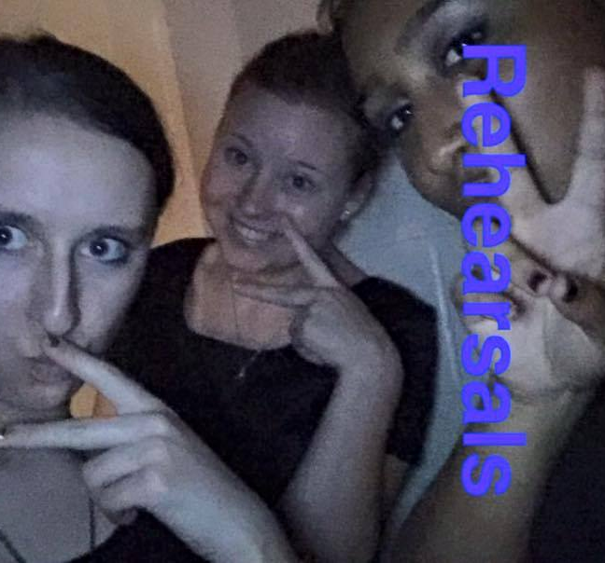
In the Dark of Night
You say that you were practicing? I don’t believe you.

Slide 36
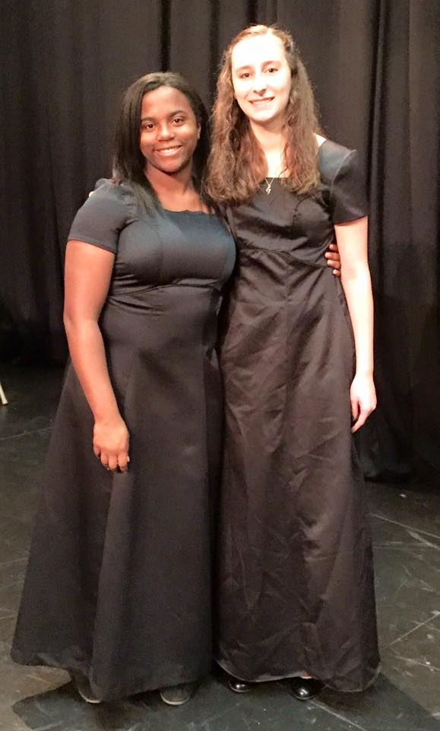
Concert Time
Good friends before a concert.

Slide 37
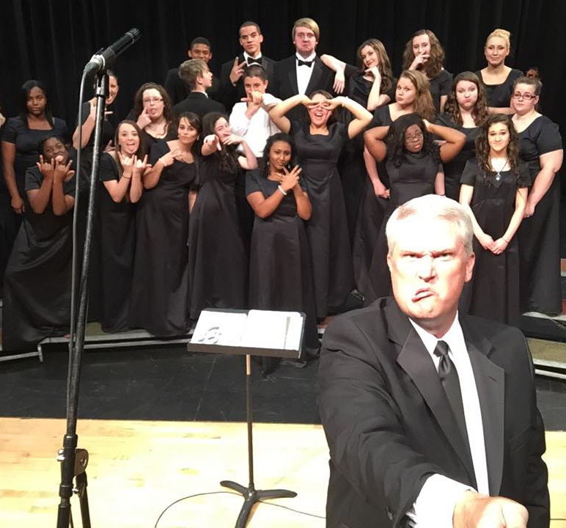
Concert Time
Everyone is doing their goofy face and Shannon is so serious!

Slide 38
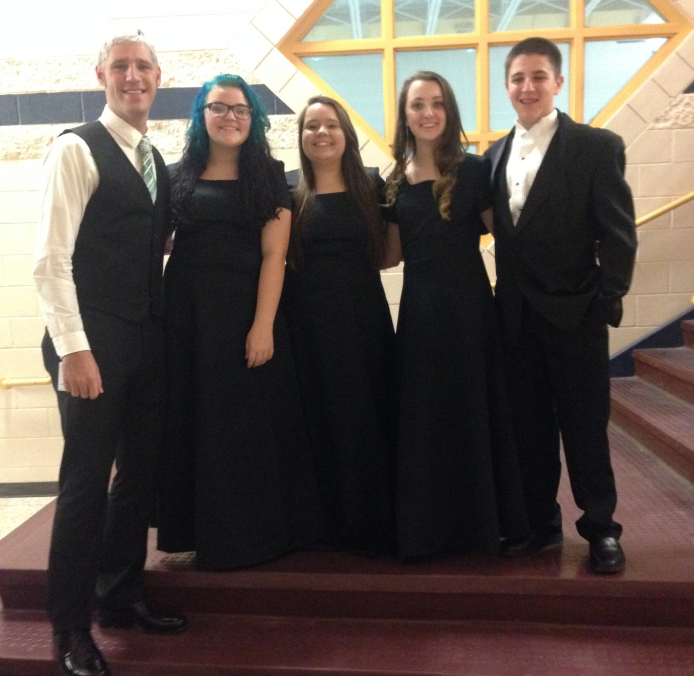
Concert Time
Students with their fave teacher! Mr. Britt who?

Slide 39
The Trip to Sandhills

Slide 40
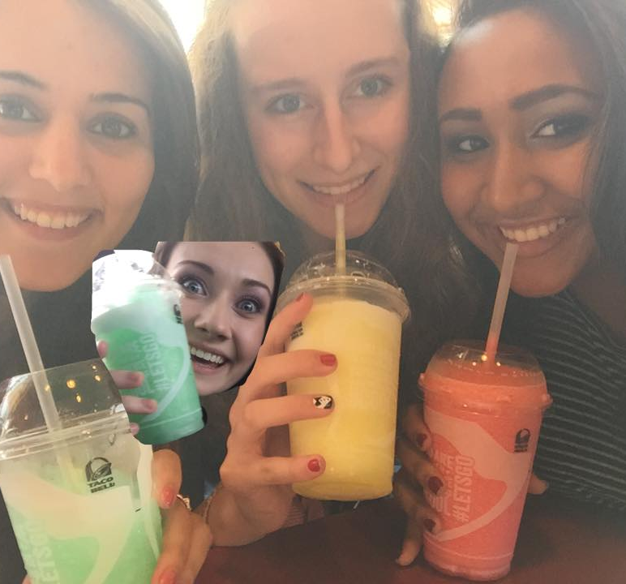
Good Friends
We got smoothies with a side of psycho!

Slide 41
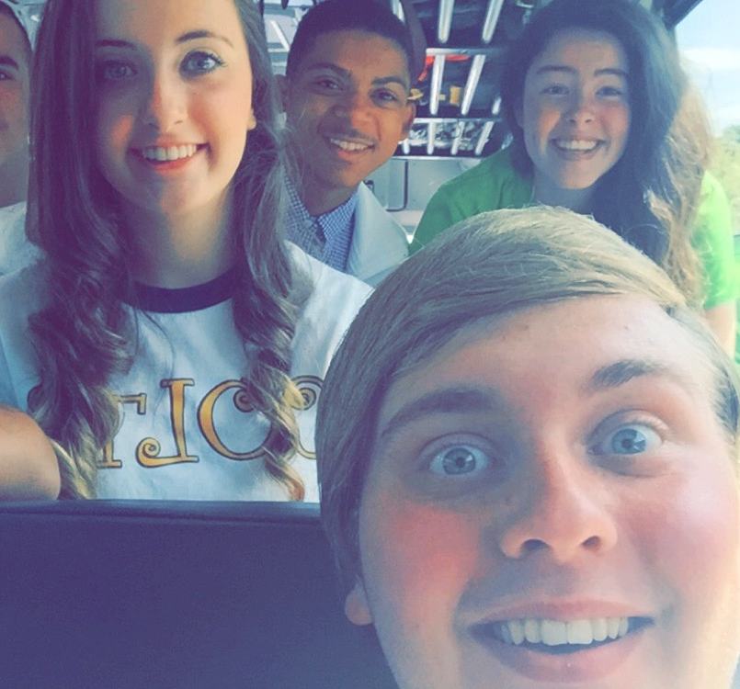
On the Bus
WOW! It flashes!

Slide 42
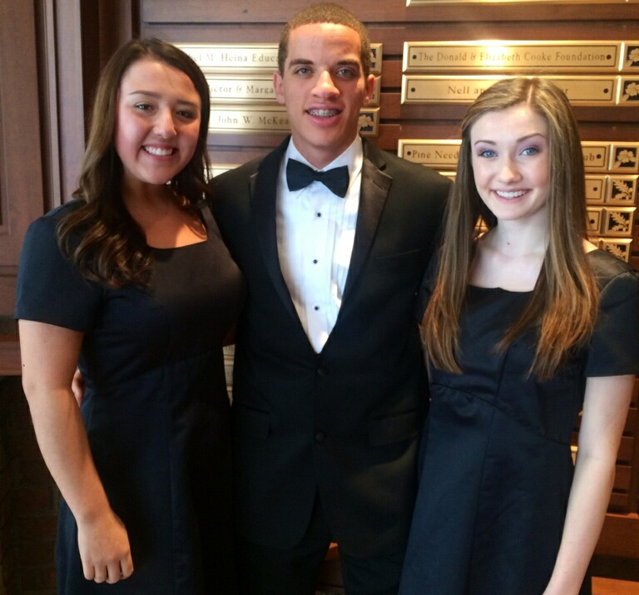
Ready to Perform
Sometimes we can get serious.

Slide 43
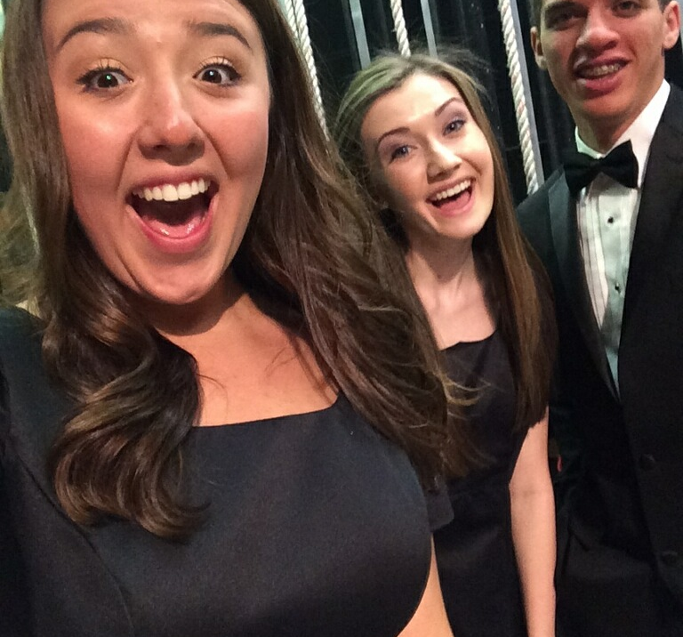
A Little Too Happy
….and the serious is over.

Slide 44
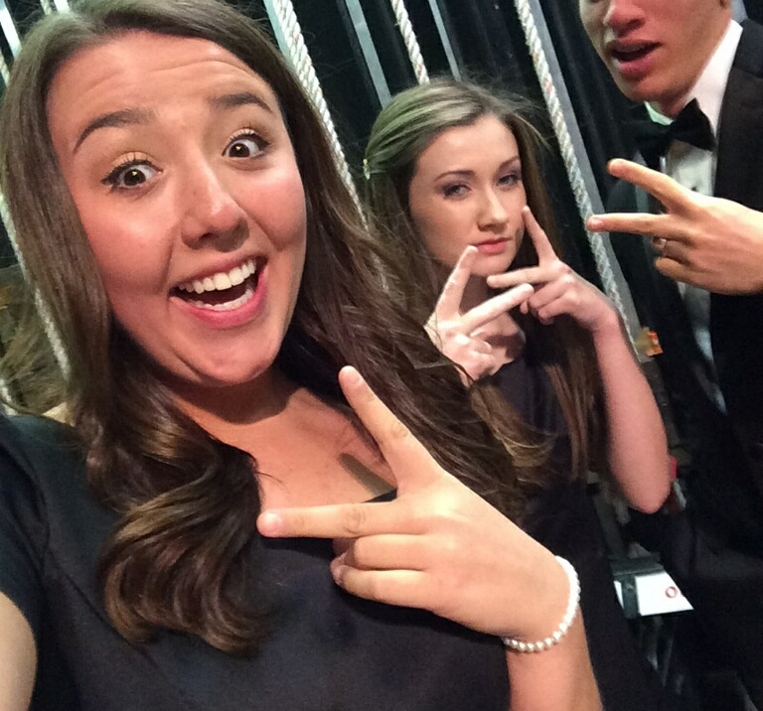
Gangsta Singer
When I say over, I mean REALLY over!

Slide 45
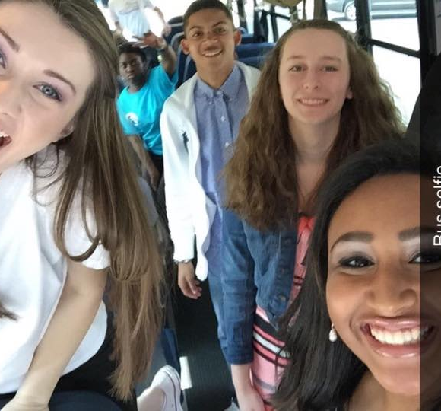
What’s a Ride Without a Selfie?
All the fun we had was on the bus ride.

Slide 46
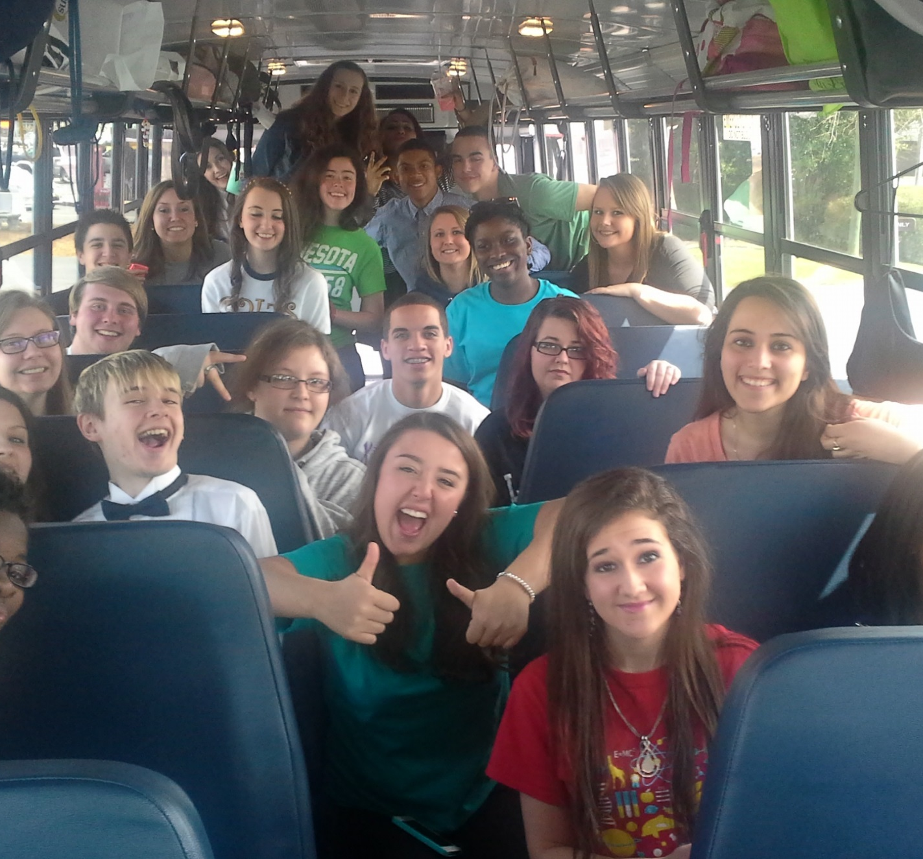
Group-tastic!!!
We even had time to take a groupie.

Slide 47
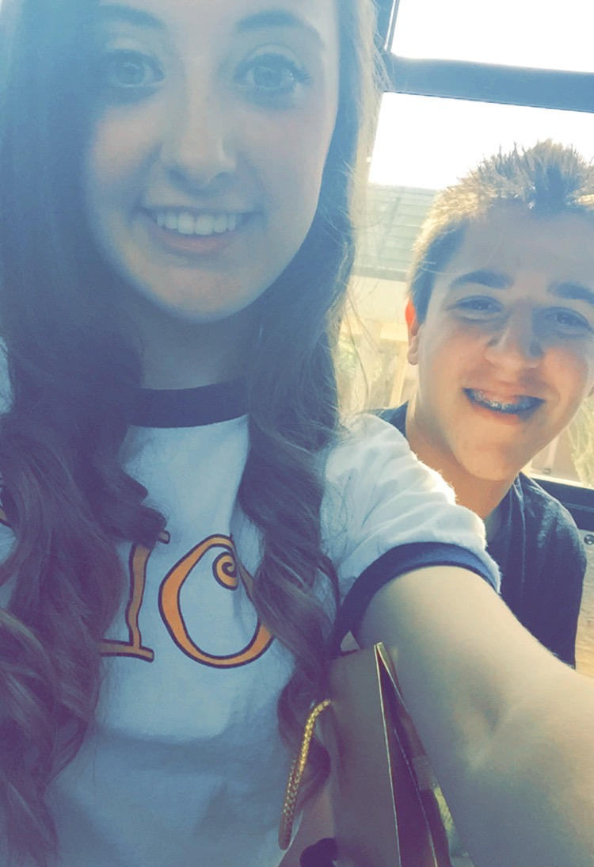
MPA
Bus rides are SOOOOO much fun!!!

Slide 48
All County Chorus

Slide 49
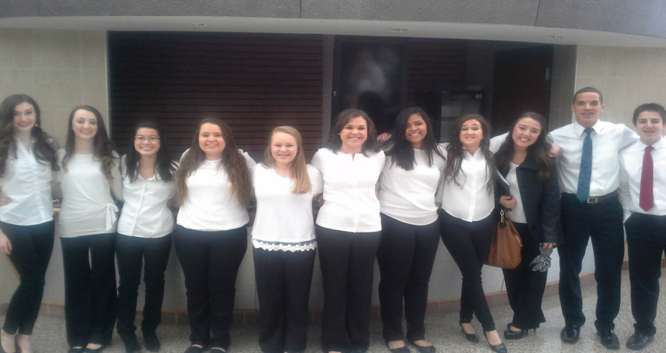
All County
Students making music

Slide 50
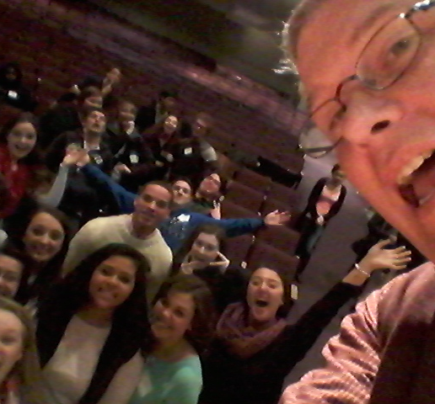
All County
Having a little fun in the down time!

Slide 51
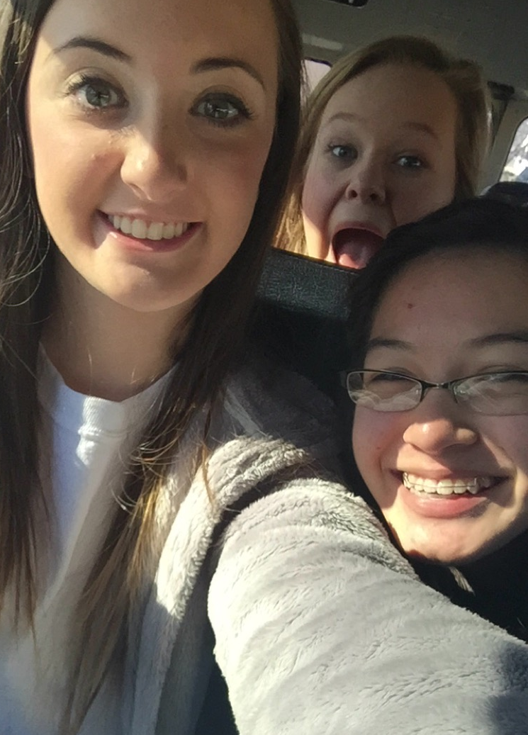
All County
On the bus fun!

Slide 52
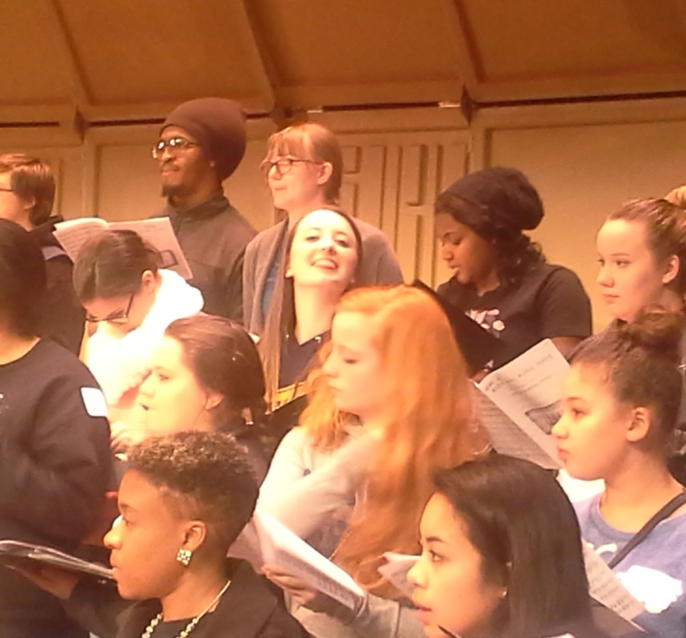
All County
Hey Amanda! Watch the director!

Slide 53
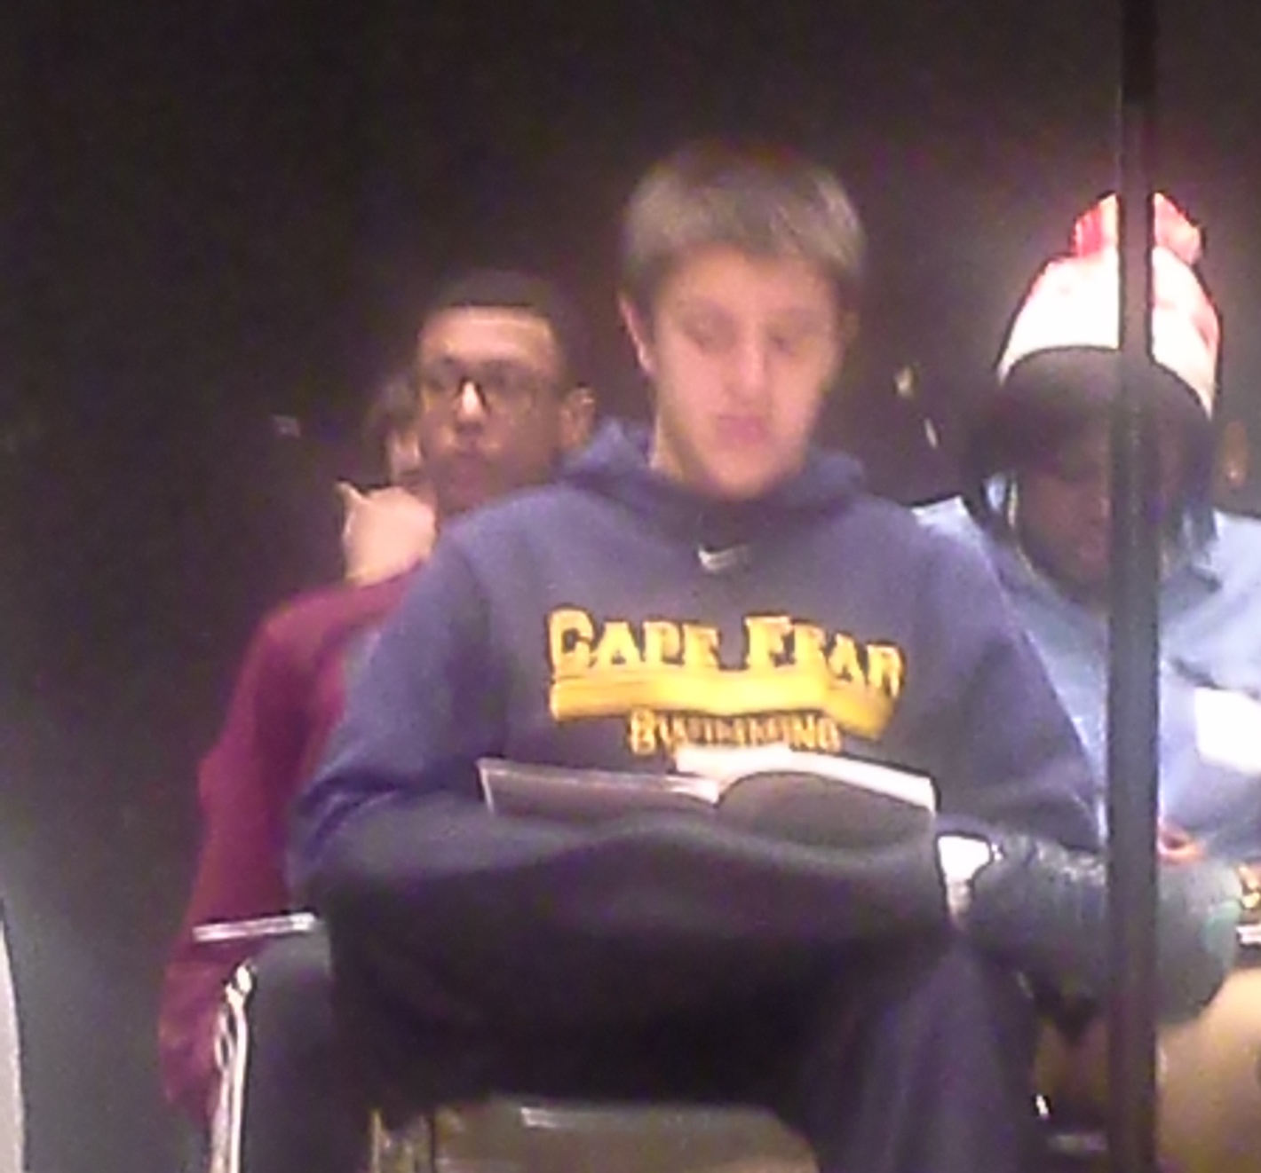
All County
I worked hard to get that picture and it still came out blurry!

Slide 54
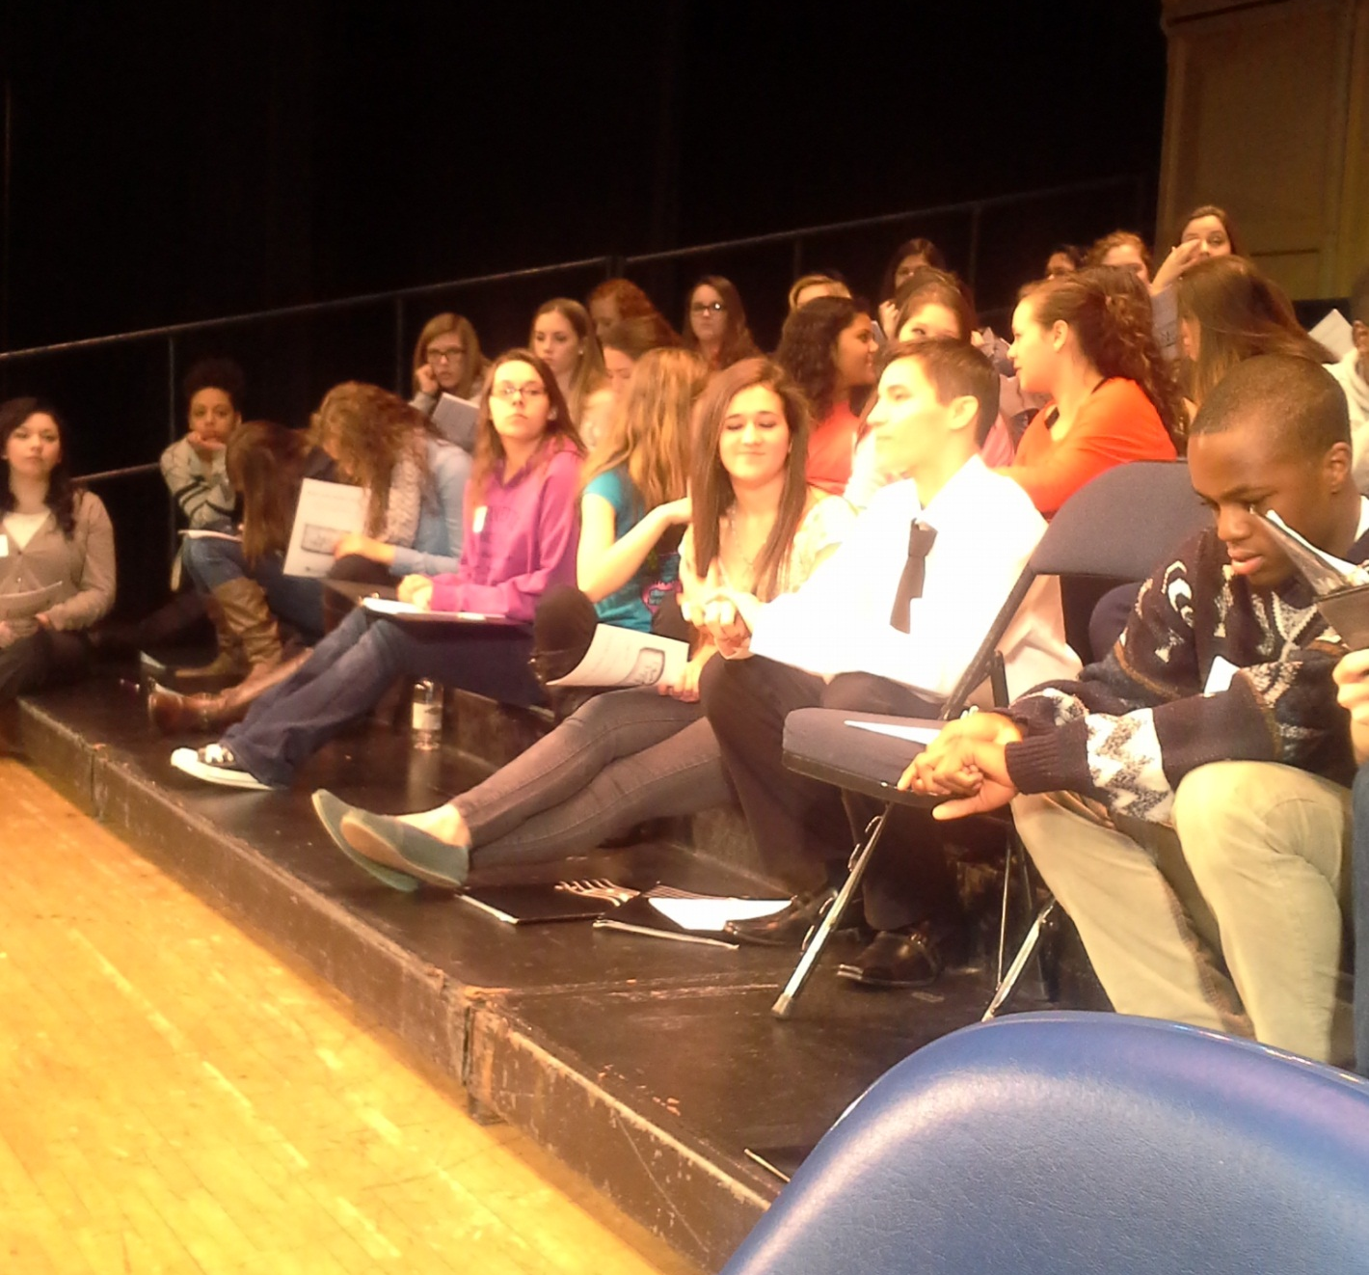
All County
Shannon says “No, you’re on the wrong page!”.

Slide 55

All County
Doing what altos do…..

Slide 56

All County
CFHS Sopranos and one photobomber.

Slide 57

All County
Schyler is focusing hard!

Slide 58
All State Chorus

Slide 59

All State
All that singing takes a lot out of you.

Slide 60

All State
Lindsey, caught by surprise!

Slide 61

All State
Here’s the performance ready group!

Slide 62
Our Leader

Slide 63

Our Leader
Any good organization starts with a competent and trusted leader.

Slide 64

Education
My first love.

Slide 65

Education
My new love!

Slide 66

Our Leader
Mr. Britt finally found the teacher of all of his online classes.

Slide 67

Our Leader
Our leader has experience in performing.

Slide 68

Days of Yore
Look to the left. Recognize anyone?

Slide 69

Our Leader
When he has time off, he likes to hold flags.

Slide 70

Grease
Not Mr. Britt, Teen Angel about to hit the stage.

Slide 71

Our Leader
Our leader can be a bit of an idiot.

Slide 72

Our Leader
Gosh! What an idiot!

Slide 73

Troubles
“Why can’t you sing that part right?”

Slide 74

T-shirt
I ordered a Schmedium!

Slide 75

CFHS
You are so lucky to be a student here. I have taught in other locations and they pale in comparison to the experiences your are receiving. I am so lucky to be your teacher. You are some of the most talented, kind, compassionate, and thoughtful bunch of people I have ever encountered. With spirits free we honor thee, our Cape Fear High!

